Slide 1
Essay ICT 304
Presented By: AMBASSA BIENVENU PROSPER 23V647 NGAKE NGASSAM BRICE 21T2773 EBENGUE DIMENE ANNICK CAROLE 23V2654 MELI SONKOUE BERNICE VEREL 21Q2393 TSAPZEU ODILON DUVAL 20R2149
Software Development Life Cycle

Slide 2



Creating New Software / Apps / Programs
How do you think new software / apps or programs are made?
HINT: what might be some of the steps that happens before, during and after its made?

Slide 3
We are going to look at how software comes to life!
Software Development Life Cycle
SDLC

Slide 4
Software Development Life Cycle (SDLC)
The development of software is very complex and can take years!
The purpose of the SDLC is to break the making of software down into manageable steps, that:
produces a piece of software that meets the users’ needs
is produced within budget
is finished on time

Slide 5

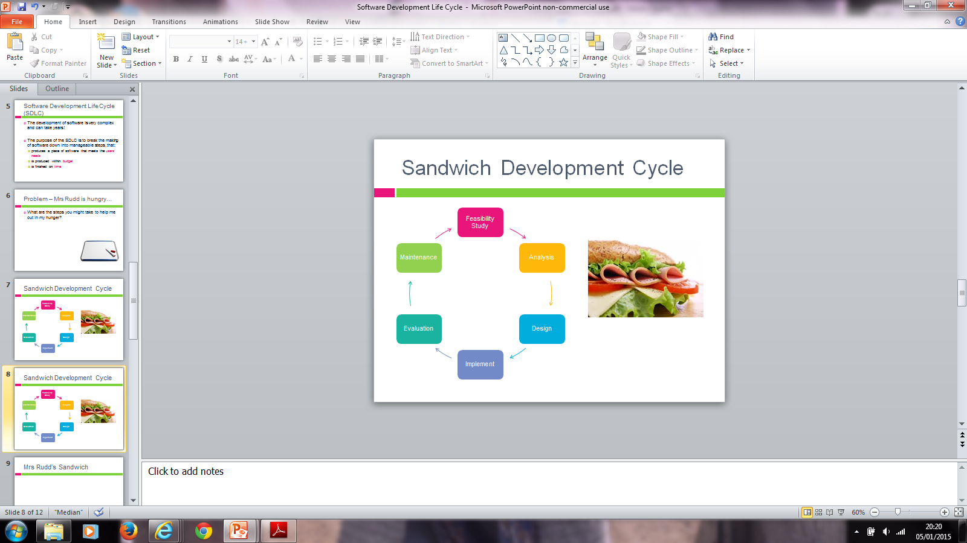
Software Development Life Cycle
It is possible and can it be done?
Remember TELOS
Technical – does the technology exist to do what we want to do?
Economical – does it make financial sense? Will we save money in the long run?
Legal – are there any copyright/licencing issues?
Operational – Will people be able to use it?
Schedule – Can it be made in time?

Slide 6
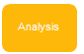
Software Development Life Cycle
What will the software need to do?
Use interviews / questionnaires / observe people / find existing documentation.
Draw diagrams that identify processes and show how data will flow around the system.
The end product is the specification and user requirements (explains what the software must do)

Slide 7
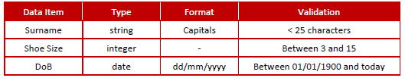
Software Development Life Cycle
Data Dictionaries
A data dictionary is used to capture what each data item looks like (data item name,
data type, any formatting needed, any restrictions on range etc). Here is an example of part of a Data
Dictionary:

Slide 8
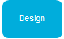
Software Development Life Cycle
The software design will include:
A detailed Data Dictionary that defines any data in the system.
Input screens/user interface
Output screens and reports
How the data will be processed: main algorithms as flow charts and pseudocode.
How the software will be tested: typically a formal test plan will be drawn up at the design stage to make sure the software is tested objectively.

Slide 9
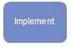
Software Development Life Cycle
Implementation includes the following activities:
Coding & Testing the software Writing documentation: technical documentation, for whoever has to support and maintain the software later, and a user guide
Installing the software for the user (if this software is written for a particular customer, as opposed to commercial off-the-shelf software).

Slide 10
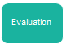
Software Development Life Cycle
Does it do what it is supposed to do?
The software must be evaluated against the original specification/User Requirement document. This is also called Acceptance Testing.
If everything works the developer can get paid!

Slide 11
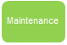

Software Development Life Cycle
Corrective maintenance – fix any bugs that come up.
Adaptive maintenance – when the software needs to change to meet new requirements.
Perfective maintenance – the user might want request performance improvements or changes to how it looks to make it easier to use.
Remember CAP!

Slide 12
Problem – Mrs Bean is hungry…
What are the steps you might take to help me out in my hunger?
¨Create a list on your whiteboards of the 5 / 6 stages of development.
¨Leave a gaps between them so that the details can be added in.

Slide 13
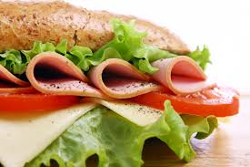
Sandwich Development Cycle
Feasibility Study
Maintenance
Analysis
Evaluation
Design
Implement

Slide 14
Sandwich Development Cycle
It is possible to make me a sandwich?
Do we have the correct equipment?
What will the costs be?
When does the sandwich need to be made by?

Slide 15
Sandwich Development Cycle
Research needs to happen as to what sandwich fillings I like, what fillings are available.
Use questionnaires / interviews to help your research.

Slide 16
Sandwich Development Cycle
Think about the shape of the sandwich e.g. triangles / squares?
Think about the layers of the sandwich e.g. ham then lettuce and tomato on top?

Slide 17
Sandwich Development Cycle
Make the sandwich!

Slide 18
Sandwich Development Cycle
Taste the sandwich and tell you what I think about it.
Do I like it?
Would I like to change it next time?
What would I take away or add?

Slide 19
Sandwich Development Cycle
Clean up any crumbs that have dropped.
Put any rubbish in the bin.

Slide 20
THANKS
FOR
YOUR
ATTENTION

